Slide 1

STUDENT NAME: A.KAVIYA
REGISTER NO :212406215
NMID:EDEEC744D8C145DA55E4D1C4071E04AD
DEPARTMENT: COMPUTER APPLICATION
COLLEGE: MANGALAM COLLEGE OF ARTS AND SCIENCE
UNIVERSITY OF MADRAS
Digital Portfolio

Slide 2


PROJEC TTITLE
Interactive digital portfolio using front end development

Slide 3
AGENDA
Problem Statement
Project Overview
End Users
Tools and Technologies
Portfolio design and Layout
Features and Functionality
Results and Screenshots
Conclusion
Github Link

Slide 4

PROBLEM STATEMENT
Sharing achievements via PDF resumes is limiting. A digital portfolio allows students to share a
personalized link with interactive content.

Slide 5
PROJECT OVERVIEW
Project Summary:
A responsive digital portfolio website created to serve as a personal showcase platform.
● Includes:
○ About Me
○ Education
○ Skills
○ Certificates
○ Contact Form
● Main Objective:
To effectively present personal achievements, technical skills, and projects in a structured and
accessible format.

Slide 6

WHO ARE THE END USERS?
Students (academic projects, resumes).Job seekers (to share with recruiters).Freelancers (to show clients).Professionals (to highlight experience and achievements).
Walt Disney

Slide 7
TOOLS AND TECHNIQUES
HTML Structure (pages, sections). CSS Styling (colors, layouts, responsiveness). JavaScript Interactivity (navigation menu, animations, form validation) Mention code editor (VS Code) hosting platform (GitHub Pages) JavaScript Interactivity (mobile navigation menu toggle)

Slide 8
POTFOLIO DESIGN AND LAYOUT
PORTFOLIO DESIGN AND LAYOUT
• Home
• About Me
• Skills
• Projects
• Achievements
• Contact
• Responsive navigation with hamburger menu
•Responsive layout (mobile ,desktop view)

Slide 9
FEATURES AND FUNCTIONALITY
• Responsive navigation bar with hamburger menu for mobile view
• Skills section displayed using simple list
•Certificates section displayed in grid format
• Contact details with email,-phone number
• Footer copyright

Slide 10
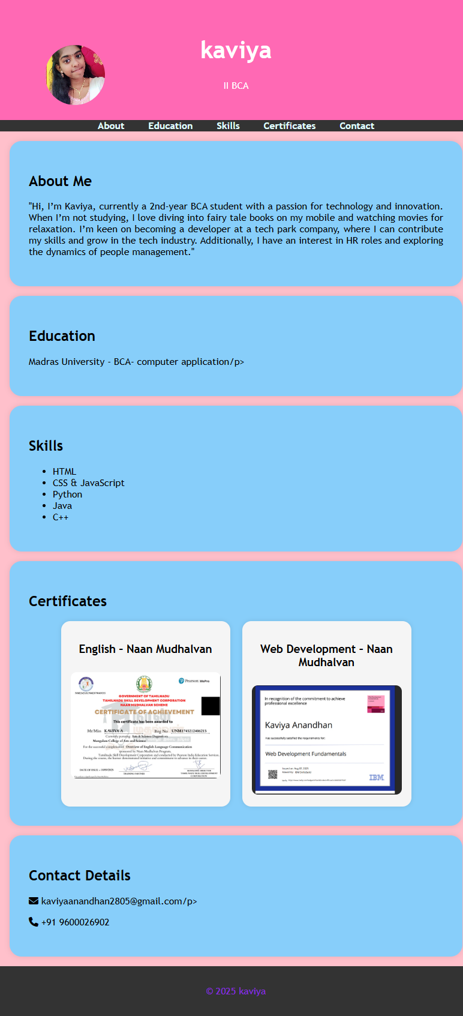
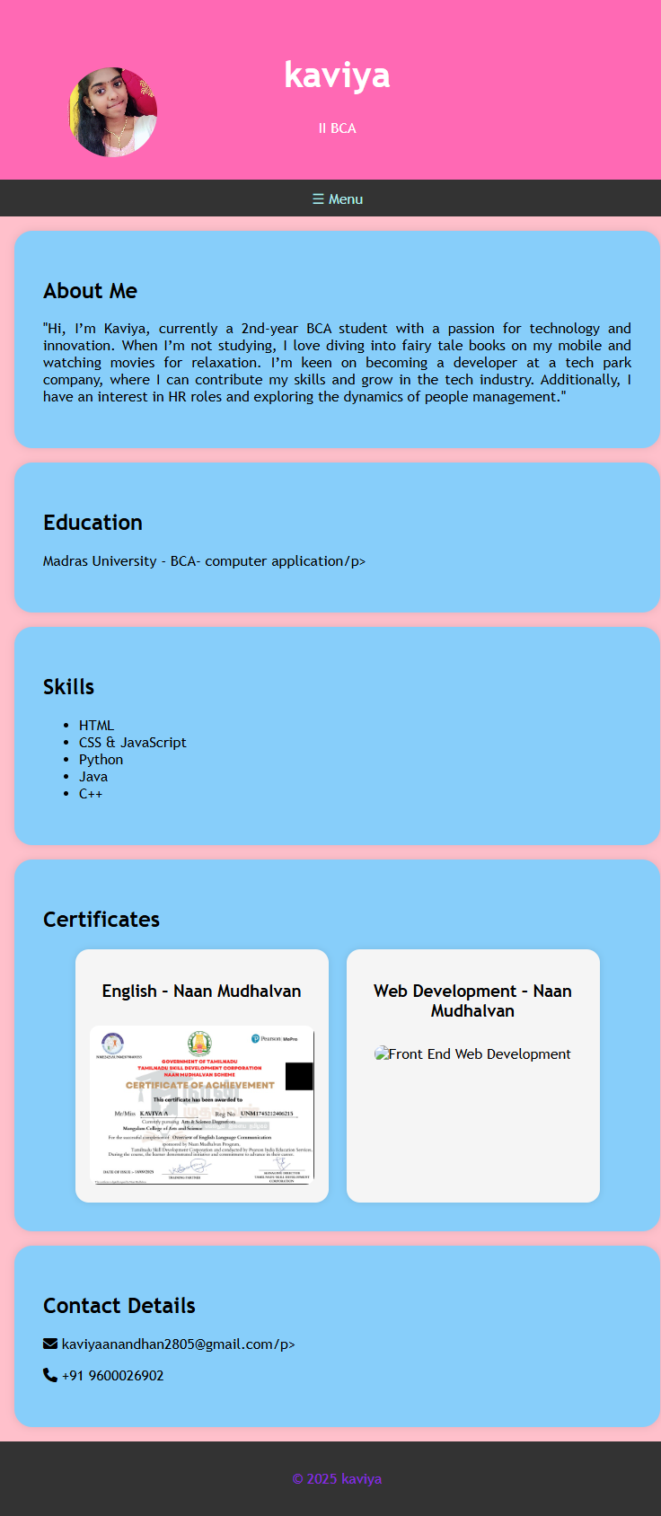
RESULTS AND SCREENSHOTS
DESKTOP VIEW
MOBILE VIEW

Slide 11



CONCLUSION
This project combines simplicity with usability. It organizes information into sections like About, Skills,
and Projects while ensuring responsive design and basic interactivity through JavaScript.
https://kaviyaanandhan2805-ux.github.io/naan-mudhalvan-prj/

